Slide 1
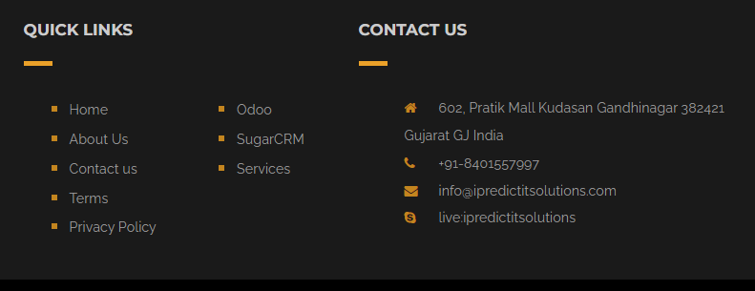
https://ipredictitsolutions.com/contactus
Term of Use
Term of Service
Copyright
Add copyrights
Term of use, term of service and copyright page make like https://ipredictitsolutions.com/terms_conditions

Slide 2

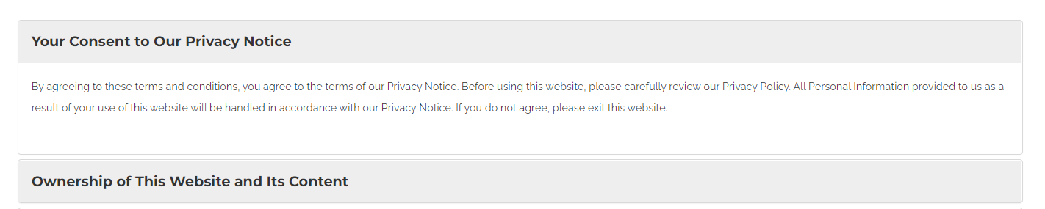
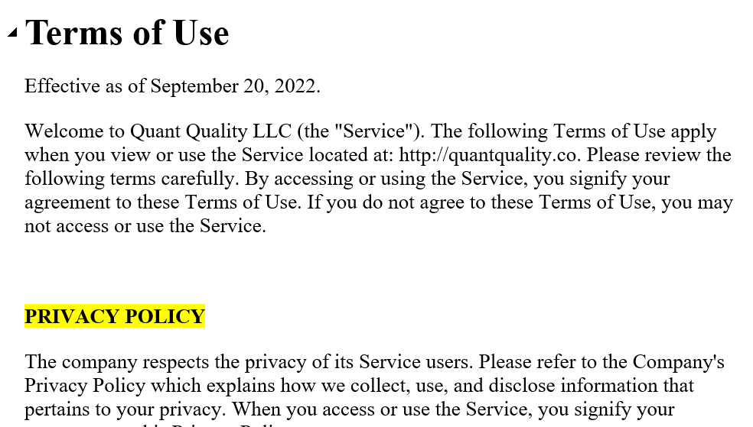
Half Page for banner
Strat line
https://ipredictitsolutions.com/terms_conditions
Below information goes at center as shown

Slide 3
Use the same font that we used on the website
You can set the font size the same as you use on the website

